Slide 1

Machine learning Workshop
Arang

Slide 2
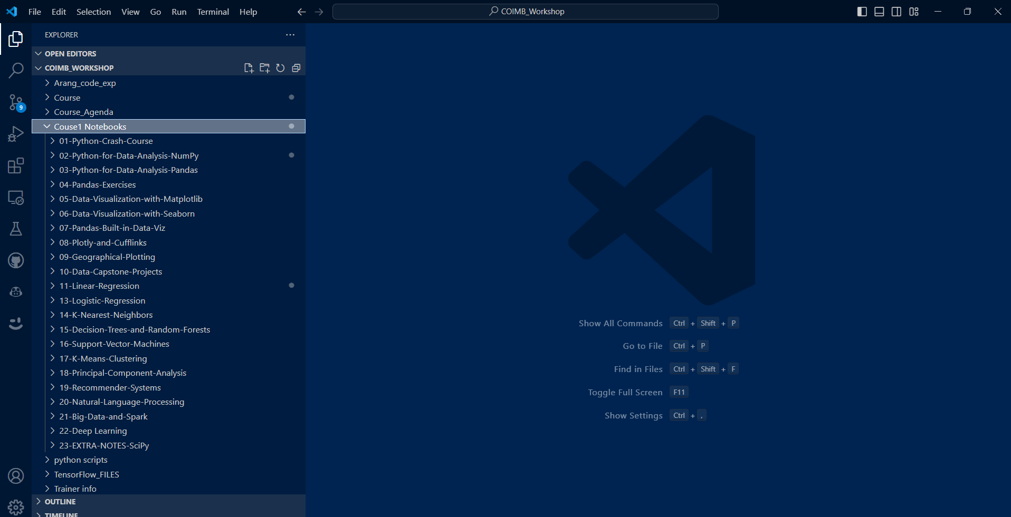
VScode

Slide 3
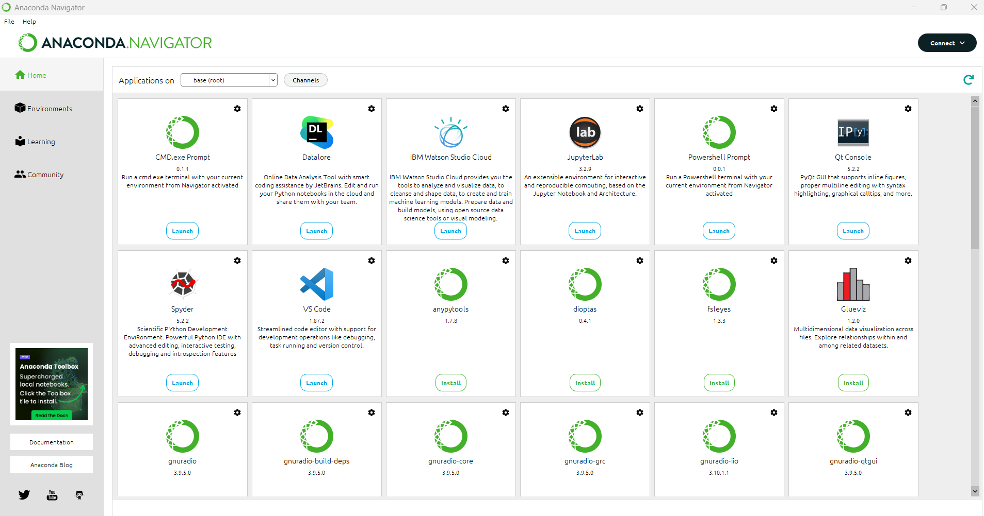
Anaconda Installation

Slide 4
Conda virtual Environment
conda create -n myenv python=3.11
or
Creation of the environment
conda create --name myenv -c conda-forge python=3.11
#Check if Conda is installed
`conda -v’
#Check if Conda is up to date
conda update conda
#Create a virtual environment
conda create -n yourenvname python=x.x anaconda
#Activate your virtual environment
conda activate yourenvname
#Install additional Python packages to a virtual environment
conda install -n yourenvname [package]
#Deactivate your virtual environment
conda deactivate
#Delete the virtual environment
conda remove -n yourenvname --all
conda activate myenv
conda deactivate

Slide 5
Python environment
pip install numpy
pip install pandas
pip install matplotlib
pip install seaborn
pip install plotly
pip install cufflinks
pip install scikit-learn

Slide 6
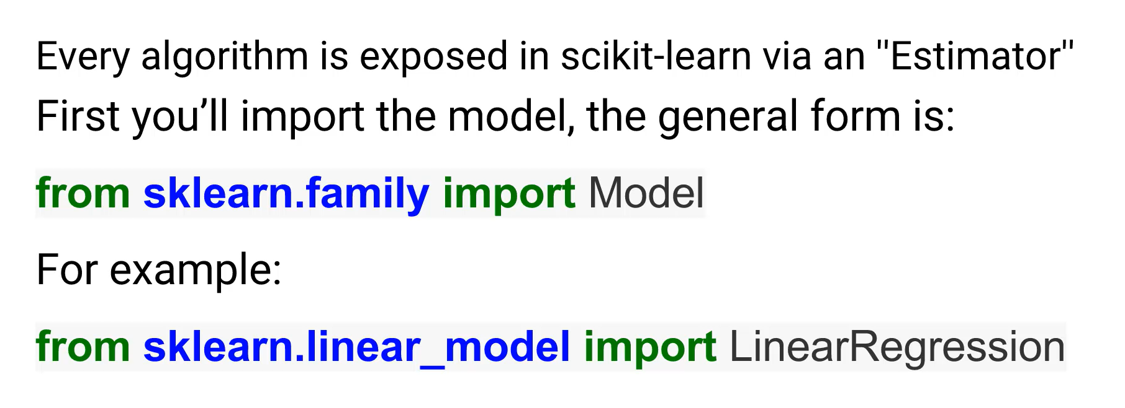
Scikit-Learn

Slide 7
Thank You!

